Slide 1
6 Software Foundations: Operation System
Dr. Xiaoming Li (lxm@lxm.name)

Slide 2
TOC
What is Operation System (OS)
What does OS do in software development
Functions provived by OS
Currenet Popular OS & how to work over OS

Slide 3
1 What is OS (Operation System)
An operating system (OS) is software, consisting of programs and data, that runs on computers and manages the computer hardware and provides common services for efficient execution of various application software.
Operating systems are found on almost any device that contains a computer—from cellular phones and video game consoles to supercomputers and web servers.

Slide 4
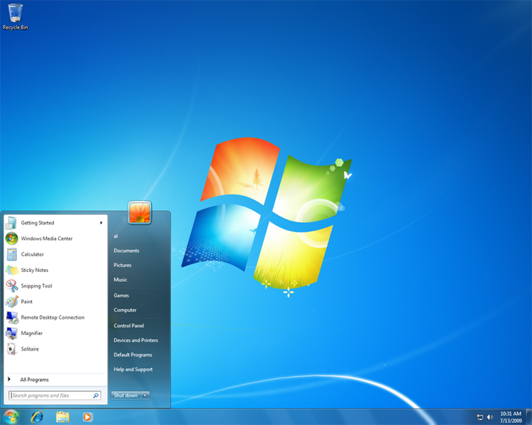
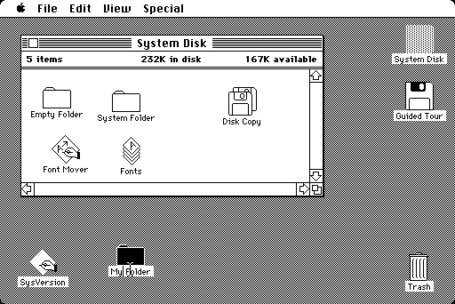
What is OS

Slide 5
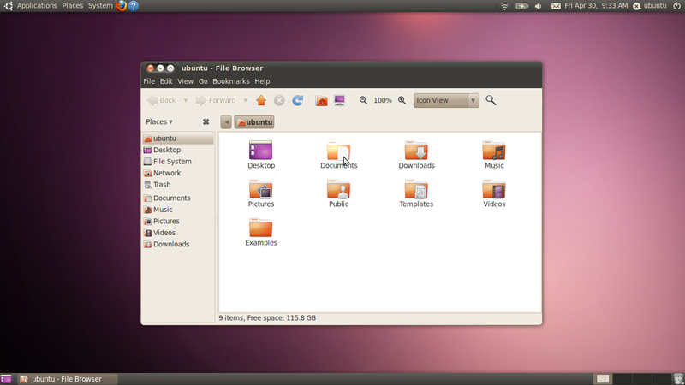

Slide 6
What is OS
First Software that runs on a pure hardware, and is used to management the hardware resources, including
CPU
Process Management
Task Management
Memory (Inner storage management)
File (Outer storage management)
Devices
Utilities

Slide 7
Multi-faces of OS
To user, OS is UI
To developer, OS is function libraries
To system administrator, OS is a collection of tools
UI
OS
Lib
Tools

Slide 8
Levels of OS
Man-machine Interface
Software Developer
Admin Tools
Utilities
Apps
API
Advanced Developer
OS kernel (Drivers)

Slide 9
2 Role of OS in software R&D
OS provides environments for Programming
Microsoft: Visual Studio, .net
Unix-like: gcc, make, python
Cross-platform: Java Virtual Machine
OS provides function interfaces for programming
OS provides run-time support for softwares

Slide 10
Example
#include <Stdio.h>
int main()
{
printf("Hello, World.\n");
}
private sub on_HelloBtnClick()
msgbox "Hello, world."
end sub

Slide 11
Example - explain
Why not super-loop?
How to get the executable?
#include <Stdio.h>
int main()
{
printf("Hello, World.\n");
}
entry point, called by OS
functions proviced by OS

Slide 12
Relation of the OS and Software R&D
The process of programming is the process of how to take use of the API provided by OS
Developer can only visit the hardware resources through the OS driver API, such as screen, keyboard, network, storage, memory, etc.
OS by itself is a software as well. It is also the object of software development

Slide 13
3 OS functions
Process Management
Storage Management
Device Management
File Management
Task Management

Slide 14
3.1 Process Management
Concept
Process is used by OS to denote the running state of software program. It is an activity that the progam is being executed together with the dataset and other resources supported by OS.
Process is the running state of program
There can be more than one process for a program
Processes can be concurrent, and there may communication between processes.

Slide 15
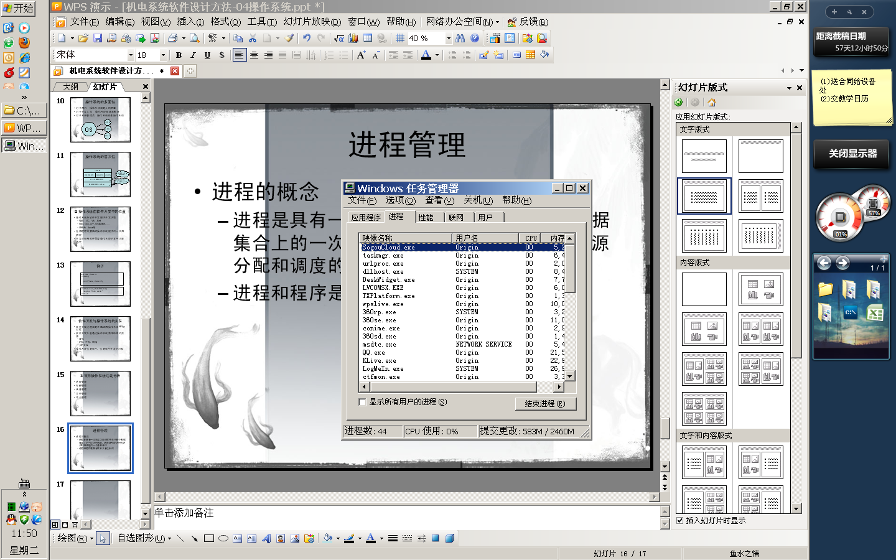
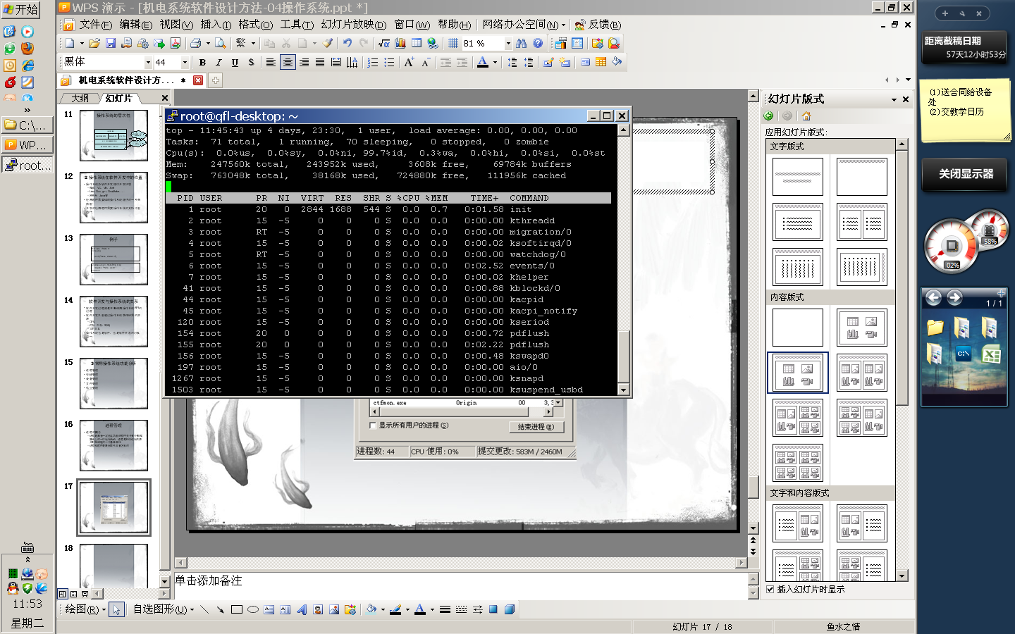

Slide 16
Life Cycle of a Process
OS load program into memory --> CREATE
Assign a time slice to this process --> RUN
Run out the time slice -->HOLD
Program finish normally, OS remove the process from memory -->DESTROY
Program finish abnormally, OS try to remove the process from memory and fails --> ZOMBEE

Slide 17
Schedule of Processes
Time slice based method
Priority of the process
Three state of a process
Ready ⇄ Wait ⇄ Run
Synchronization & Mutual Exclusion
Synchronization is a relationship of cooperation
“I will wait for you!”
Mutual Exclusion is a relationship of Competation
“I have occupied this place!”
Deadlock

Slide 18
Communication between processes
Ways of communication
Pipeline
Signal
Shared Memory
OLE technology
...

Slide 19
3.2 Memory Management
Deals mainly with:
Allocation of the memory space
Protection of the memory space of a process
Remapping of the memory address
Expandation of the memory (Virtual Memory Management)

Slide 20
Memory Management
Technology
Partition management
Page storage management
Segment storage management
Segmented Paged Memory Management
Virtual storage management

Slide 21
3.3 Device Management
Functions
Provides universal interface
Assign devices to processes
Improve the efficiency of devices by utilizing interrupts, pipes, caches/Buffers, etc.
Pipe: a technology of direct data interchange between memory and devices
Cache / Buffer: solve the bottle-neck of CPU and devices

Slide 22
3.4 File Management
File: Collection of data, with a name reference
File Storage
File Directory
File access method
Sequential: fread()/fwrite()
Random: fseek()

Slide 23
4 Popular OS
Windows
MS Visual Studio / .NET
Unix
GNU C/C++
Linux
GNU C/C++
Mac OS
XCode / C

Slide 24
Cross-platform Programming
OS-independant
Using Virtual Machine or Interpretor to hide OS
Example: Java, Python
In another way, Java or Python can work on their own “Operation System”

Slide 25
Best programming practice
Hybrid programming
Java / Python for general purpose programming
C/C++ for OS specific programming, e.g. visiting hardware
Benifits
Write once, run everywhere
Minimal OS specific codes

Slide 26
Conclusion
Knowldege about operation system is important for programmers
Cross-OS is not neglecting the OS, its a re-capsulation of OS
Hybrid programming is an effective way in practice.

